Slide 1

TECH MEETUPS

Slide 2
Project Proposal
Goals and Objectives
The main aim of this project is to develop an online web application called “Tech Meetups” With the help of the web app user can register for events around and can participate in various events and can check their details such as for which events they are registered. New Users can register to access the meetups. Moreover, admin can add new events, edit and delete the existing events. Also, admin can delete registration and can access the details of registrations. Admin has right to edit, delete and access details of the participants for the events.

Slide 3
Project Specifications
Admin can login/logout successfully.
Valid username and passwords are allowed
Admin can add, edit, delete events.
Admin can edit, delete and access details of participants
Admin can delete and access the registration.
User can login/logout successfully,
New User can register successfully
User can participate in Events
User can register for events and check details of the events.
Admin can register new admin.

Slide 4

Detail Design HOME PAGE
This is main landing page of the Web application. On the Navigation bar of this page there are menu options such as Home, Meetups, Sign up Participants, Register a Meetup Admin and Login.

Slide 5
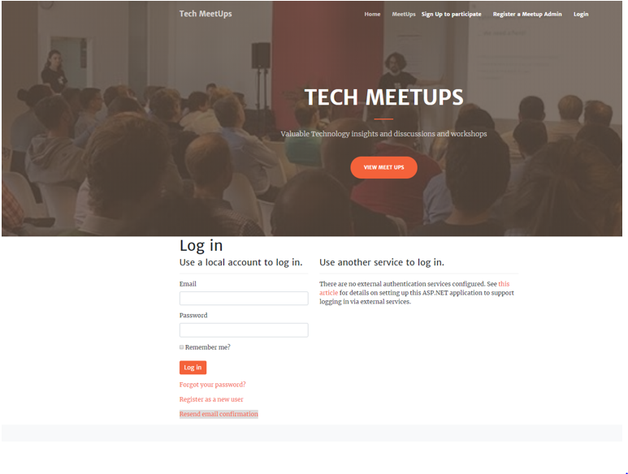
LOGIN PAGE
This Page is helpful for both Admin and users to login to the application by using their credentials.

Slide 6
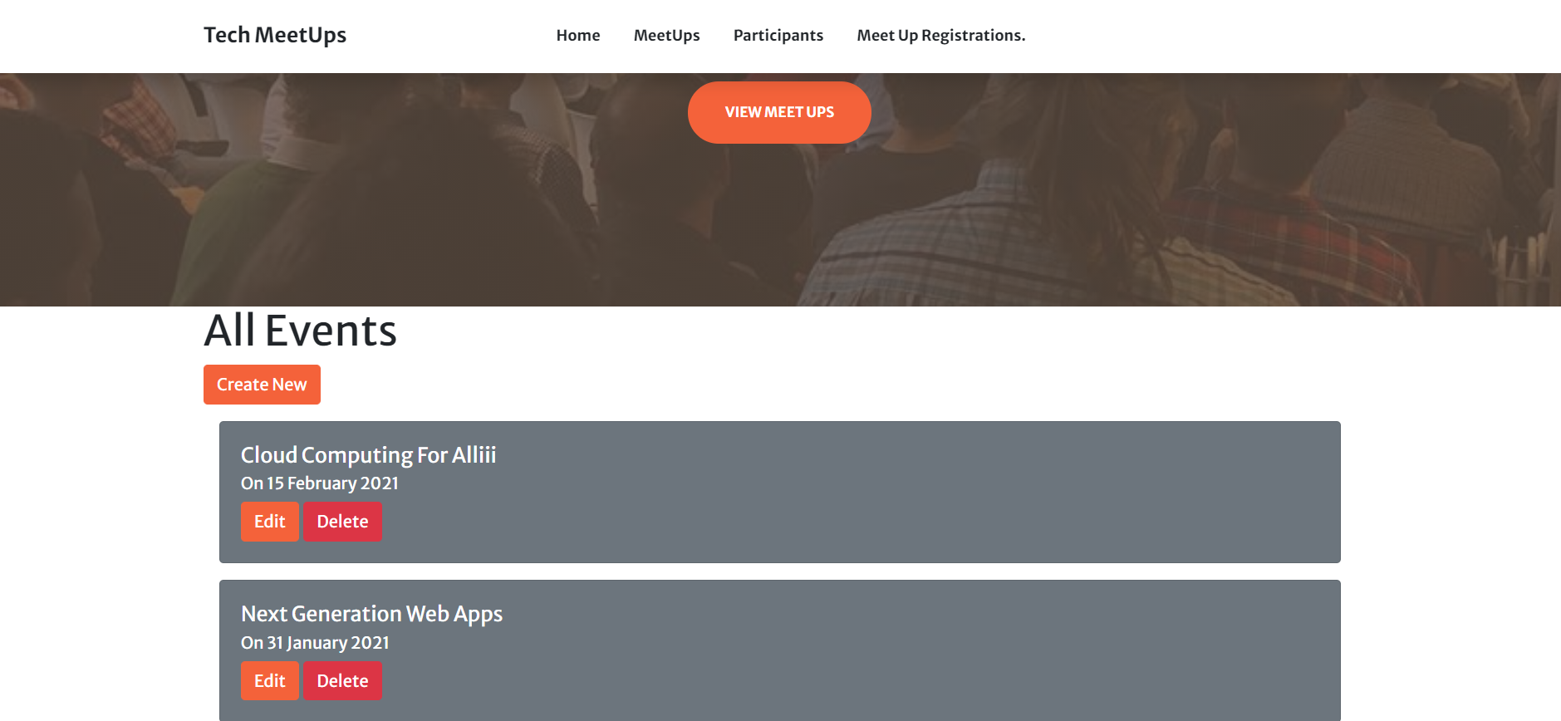
Admin Meetup Page
This page will highlight the details of all Events. An Admin can create new events. Also, can edit and delete events.

Slide 7
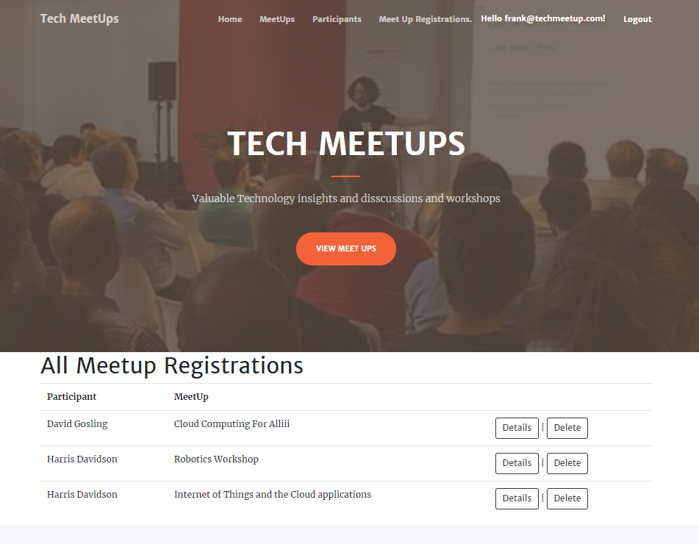
Admin Meetup Registration Page
With the help of this page admin can delete meetup registrations and can access the details of the meetups.

Slide 8
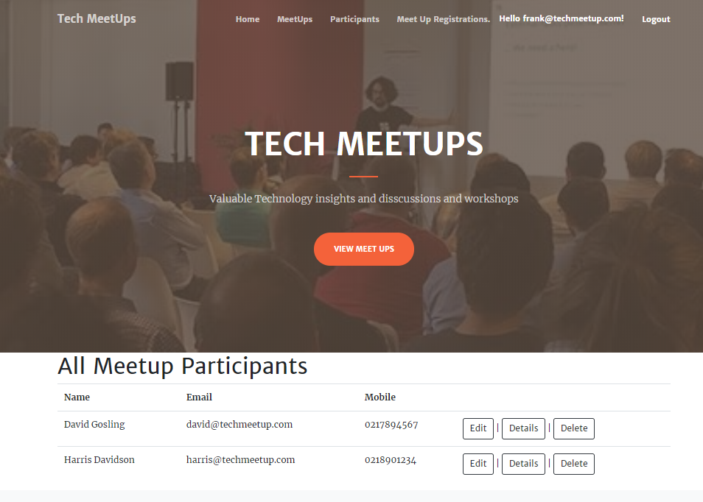
Admin Participant Page This page will highlight the details of the participants who have registered for the events. Admin can access, edit and delete the participants.

Slide 9
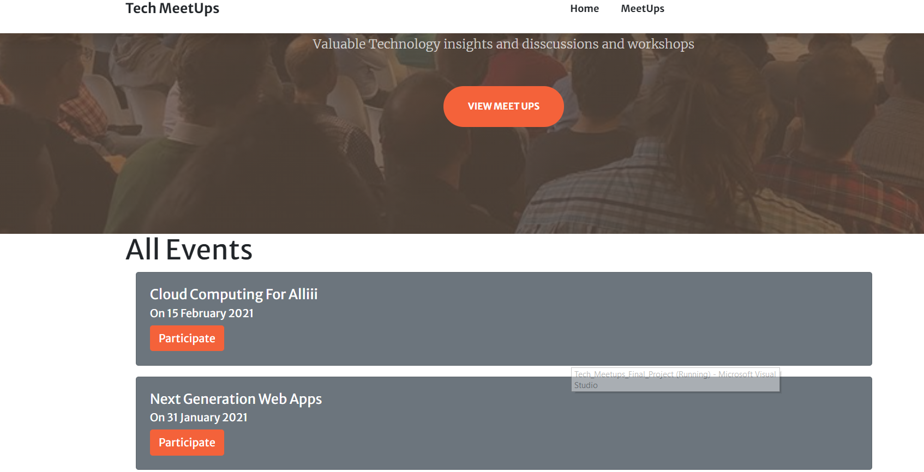
User Meetup Page This page will highlight all the events to the user and user can participate in the events by clicking on the participate option.

Slide 10
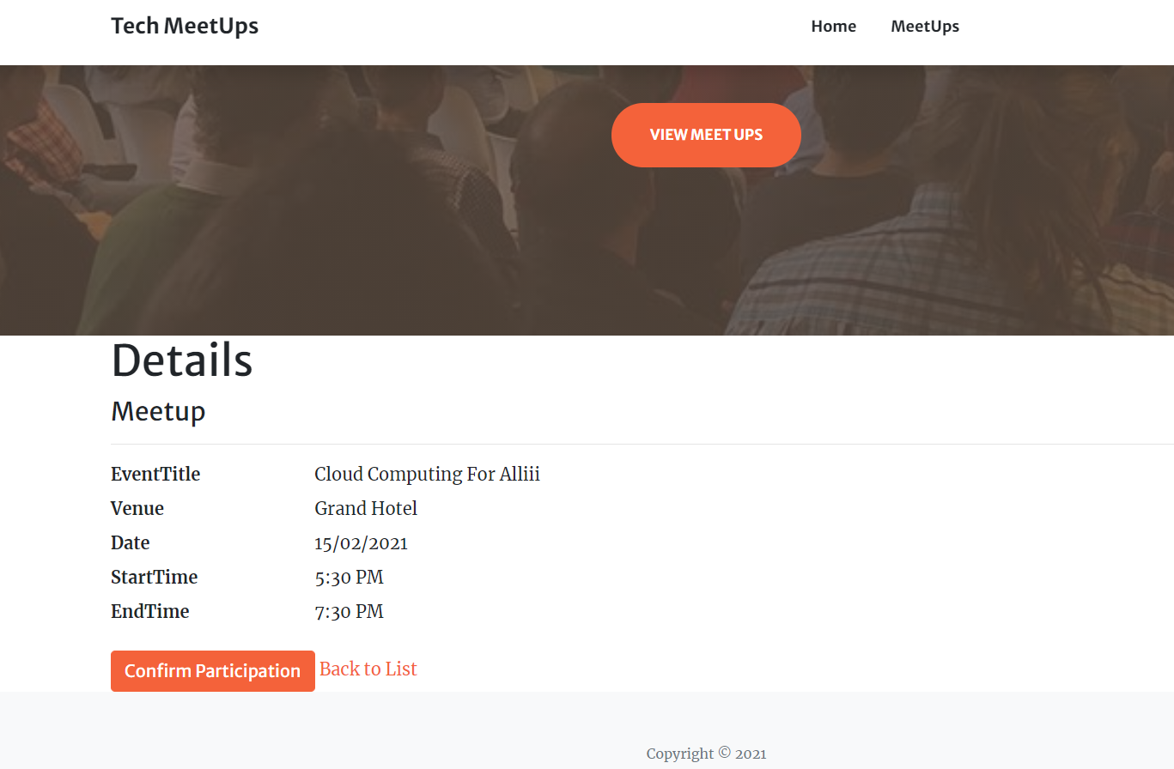
User Participation Page This page will highlight the details of the events and user can confirm the participation for a particular event.

